Slide 1
Staggered PRT Update
Part II
  David Warde and Sebastián Torres
CIMMS/The University of Oklahoma
and National Severe Storms Laboratory/NOAA

Slide 2
Background
CLEAN-AP
Staggered PRT
Dual Polarization
Dual Polarization Staggered PRT with CLEAN-AP

Slide 3
CLEAN-AP Filter Characteristics
CLEAN-AP © 2009 Board of Regents University of Oklahoma
Dual-polarization, SPRT
Automated ground clutter mitigation
  Detection
  Filtering
Meets WSR-88D performance standards
    Clutter Suppression
    Z/V/W Bias
    Error of estimates
Spectral domain (Lag-1 ASD)
Compatible with current and future upgrades to WSR-88D
    Dual-polarization, SPRT, range oversampling, etc.

Slide 4
Understanding CLEAN-AP
Lag-1 Autocorrelation Spectral Density
Window & DFT
F1
V₁
S₁(k) = F₀*(k)F₁(k)
0
1
M -1
M
sample time
V₀
Window & DFT
F₀
For periodic signals F₁(k) = F₀(k)e^{j2πk/M}
  S₁(k) = S (k) e^{j2πk/M}
  ASD is PSD with a linear phase component

Slide 5


SPRT Ground Clutter Mitigation Challenge
  Staggered PRT – non-uniform sampling
Filtering ground clutter
  Common ground clutter filters
    Designed to operate on uniform sequences
      Time domain – DC removal, regression, FIR, etc.
      Spectral domain - GMAP, notch, etc.
    Performance does not meet WSR-88D system requirements
  SACHI (Sachidananda and Zrnić, J. Atmos. Oceanic. Technol. 2000)
    Specialized ground clutter filter
    Staggered PRT ratio of 2/3
    Spectral domain
    Performance meets WSR-88D system requirements
Mitigating (detection and filtering) ground clutter
  CLEAN-AP
    Operates on uniform sequence

Slide 6
ASD in Staggered PRT m/n = 2/3
Ground Clutter
PSD
T_{m}= 2T_{u}
Weather
T_{n} = 3T_{u}
T_{m}+ T_{n} = 5T_{u}
ARG[ASD(2T_{u})]
2Va
2V_{a}/5
T_{m}+T_{n}
ARG[ASD(3T_{u})]
T_{u}
T_{m}
T_{n}
ARG[ASD(5T_{u})]

Slide 7
Dual Polarization SPRT with CLEAN-AP
CLEAN-AP
Replaces SACHI
PSD
Filter
Slave
ASD_{mTu}
Filter
Slave
R_{h} (0T_{u})
R_{h} (mT_{u})
R_{h} (nT_{u})
R_{hv}(oT_{u})
V_{Horz.} V_{Vert.}
ASD_{nTu}
Filter
Slave
SPRT
VDTF
Horz.
Detection
Master
ASD_{(m+n)Tu}
Vert.
Further
Processing
ASD_{(m+n)Tu}
CSD_{hv}
Filter
Slave

Slide 8
Reflectivity
KOUN, March 4, 2004, El. 2.4°
Unfiltered (Time Domain)
CLEAN-AP (Spectral Domain)

Slide 9
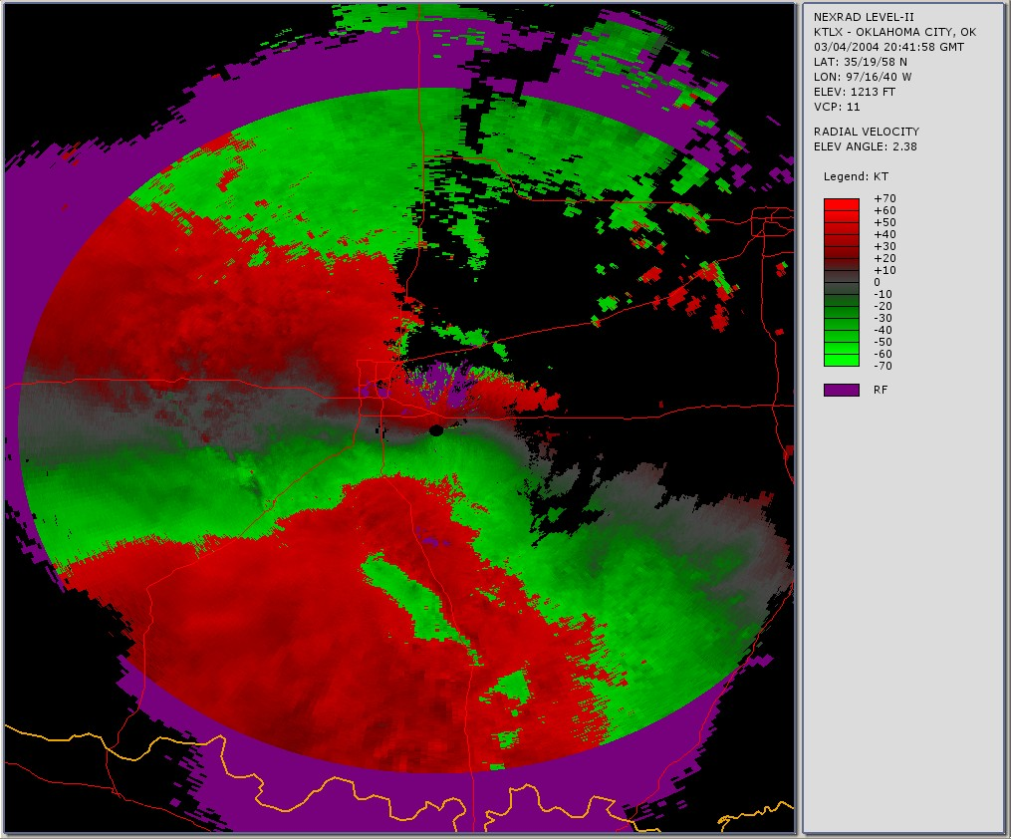
Velocity
KOUN, March 4, 2004, El. 2.4°
KTLX (Batch)
CLEAN-AP (Spectral Domain)
Unfiltered (Time Domain)
Obscured velocities
Range folding
Velocity aliasing

Slide 10
Spectrum Width
KOUN, March 4, 2004, El. 2.4°
Unfiltered (Time Domain)
CLEAN-AP (Spectral Domain)

Slide 11
Differential Reflectivity
KOUN, March 4, 2004, El. 2.4°
Unfiltered (Time Domain)
CLEAN-AP (Spectral Domain)

Slide 12
Correlation Coefficient
KOUN, March 4, 2004, El. 2.4°
Unfiltered (Time Domain)
CLEAN-AP (Spectral Domain)

Slide 13
Differential Phase
KOUN, March 4, 2004, El. 2.4°
Unfiltered (Time Domain)
CLEAN-AP (Spectral Domain)

Slide 14
Summary
SPRT (spectral processing)
  Compatible with time domain processing
  Real-time, automatic, ground clutter mitigation
    Detection
    Filtering
  Dual-polarization
  General m/n ratio (not limited to 2/3 ratio)
Performance meets WSR-88D system requirements

